Slide 1
Social media depression detection
Submitted By :
160121733162 V.Srinidhi
160121733163 Y.Manasvi
160121733164 A.Meghanath

Slide 2
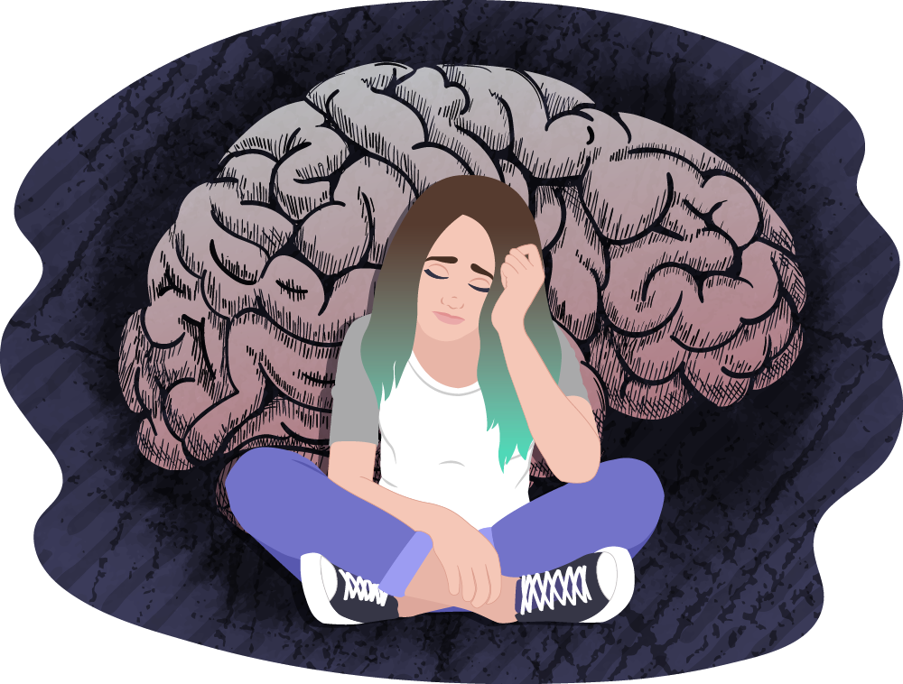
Introduction
Depression (major depressive disorder) is a common and serious medical illness that negatively affects how you feel, the way you think and how you act. Fortunately, it is also treatable. Depression causes feelings of sadness and/or a loss of interest in activities you once enjoyed. It can lead to a variety of emotional and physical problems and can decrease your ability to function at work and at home.

Slide 3
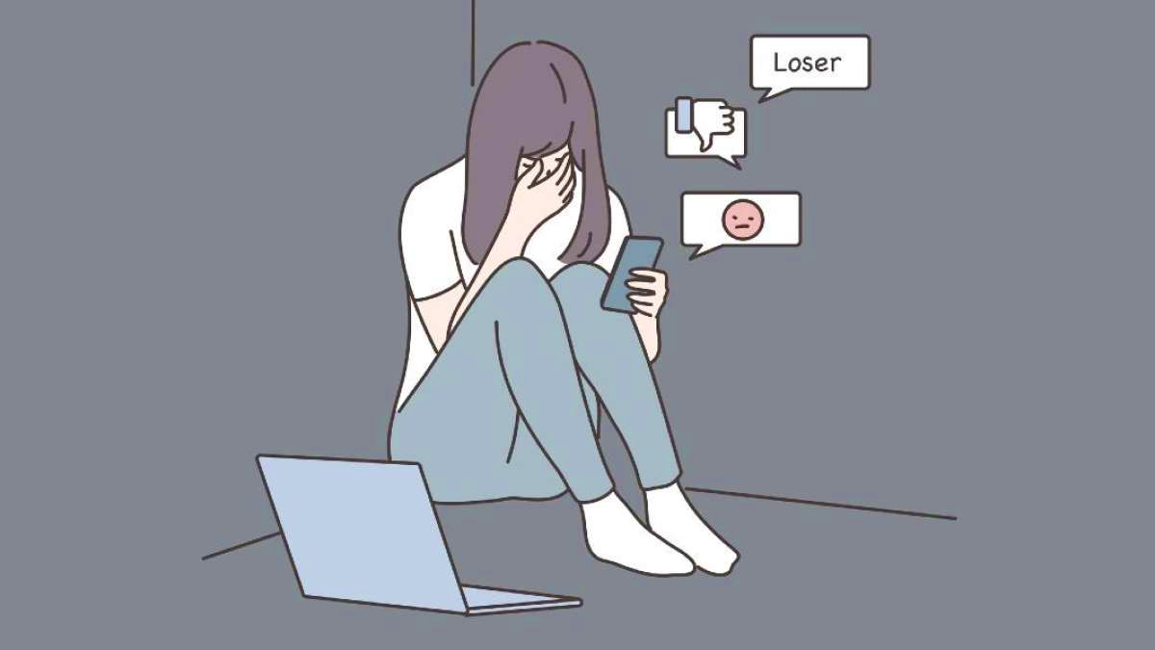
How Social Media causes depression
Social media's impact on depression is a complex issue with various factors at play. While social media platforms offer opportunities for connection, self-expression, and information sharing, they can also contribute to feelings of depression and anxiety for some users. Here are some ways in which social media may affect depression:
1. Social Comparison: People often present idealized versions of themselves on social media, showcasing their best moments and achievements. Constant exposure to these curated images and lifestyles can lead to feelings of inadequacy and low self-esteem in individuals who compare themselves unfavorably.
2. Cyberbullying: Social media platforms can be breeding grounds for cyberbullying, where individuals are harassed, mocked, or insulted online. Cyberbullying can have serious emotional consequences, leading to feelings of depression, anxiety, and even suicidal thoughts in some cases.
3. Fear of Missing Out (FOMO): Seeing others' posts about social gatherings, vacations, or achievements can evoke a fear of missing out on exciting experiences. This fear can exacerbate feelings of loneliness and depression, especially for individuals who already feel socially isolated.

Slide 4
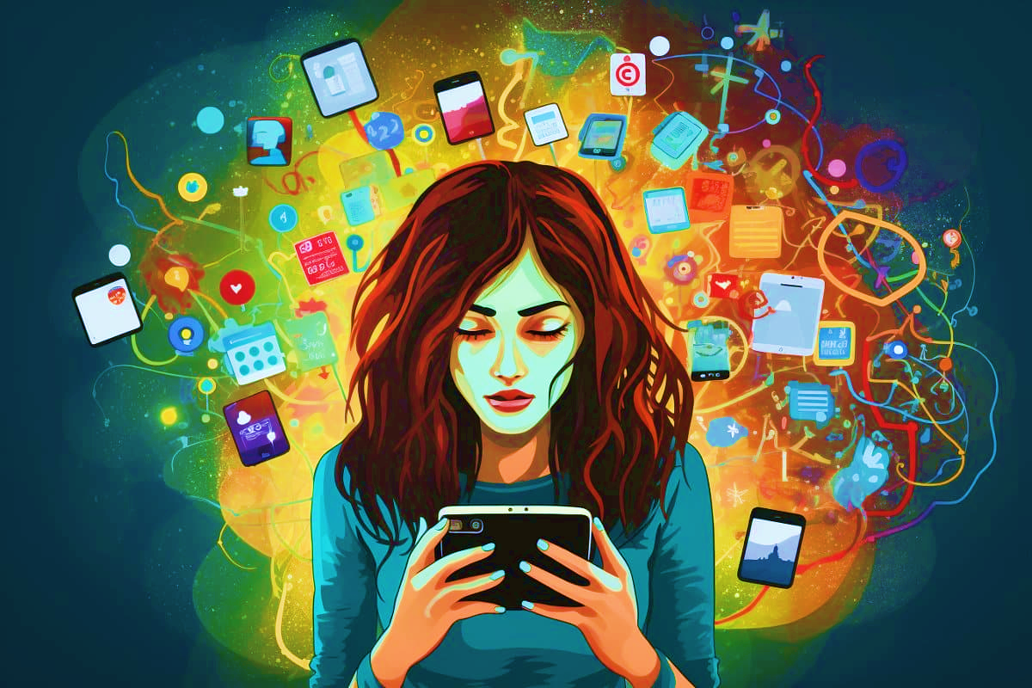
4. Addiction and Time Wasting: Excessive use of social media can lead to addiction-like behaviors, where individuals spend excessive amounts of time scrolling through their feeds or seeking validation through likes and comments. This can detract from real-life interactions and activities that promote mental well-being, leading to feelings of emptiness and dissatisfaction.
5. Negative Content Exposure: Constant exposure to negative news stories, violent images, or upsetting content on social media can contribute to feelings of anxiety and depression. While it's important to stay informed, being inundated with distressing information can take a toll on mental health.
6. Sleep Disruption: The use of social media, particularly before bedtime, can disrupt sleep patterns, leading to fatigue and mood disturbances. Poor sleep quality is strongly associated with an increased risk of depression.
7. Social Isolation: Paradoxically, excessive use of social media can lead to social isolation by substituting online interactions for real-life connections. This can contribute to feelings of loneliness and depression, especially if individuals lack meaningful offline relationships.

Slide 5
Building Model for detection

Slide 6
WorkFlow Diagram
DataSet Collection
Data preprocessing
Data Partitioning
ML Algorithm
Result Analysis
Predictions

Slide 7
Python Libraries Used
o Pandas
o NLP
o NLTK
o Multinomial Naive Bayes
o Gaussian Naive Bayes
o Numpy

Slide 8
Models Used

Slide 9
Conclusion & Future Scope
The objective of this project was to detect Depression using sentiment Analysis. For this purpose, a dataset was collected from the Kaggle . It was pre-processed and clean to prepare it for further use. Then the dataset was split into 80%-20% partitions for Training and Testing respectively. Further, popular ML algorithms, Naive Bayes . The results obtained after experiments show that the Naive Bayes technique resulted in a classification accuracy of more than 84%.
As a future work in this research, other Machine Learning techniques and Deep Learning techniques can be applied for better prediction accuracy. Moreover, a dataset consisting of many instances can be collected and used for performing experiments.

Slide 10
Thank You

